Slide 1

COSY AIRCONDITIONER

Slide 2

INTRODUCING COSY_AIRCONDITIONER
Welcome to COSY AIRCONDITIONER, where we are dedicated to providing the highest quality air conditioning solutions for your home or business. Our state-of-the-art technology ensures that you will always enjoy a comfortable and healthy indoor environment, no matter what the weather is like outside.

Slide 3
Features and Benefits
Smart temperature control, energy efficiency, and improved air quality for a comfortable and healthy living environment.

Slide 4
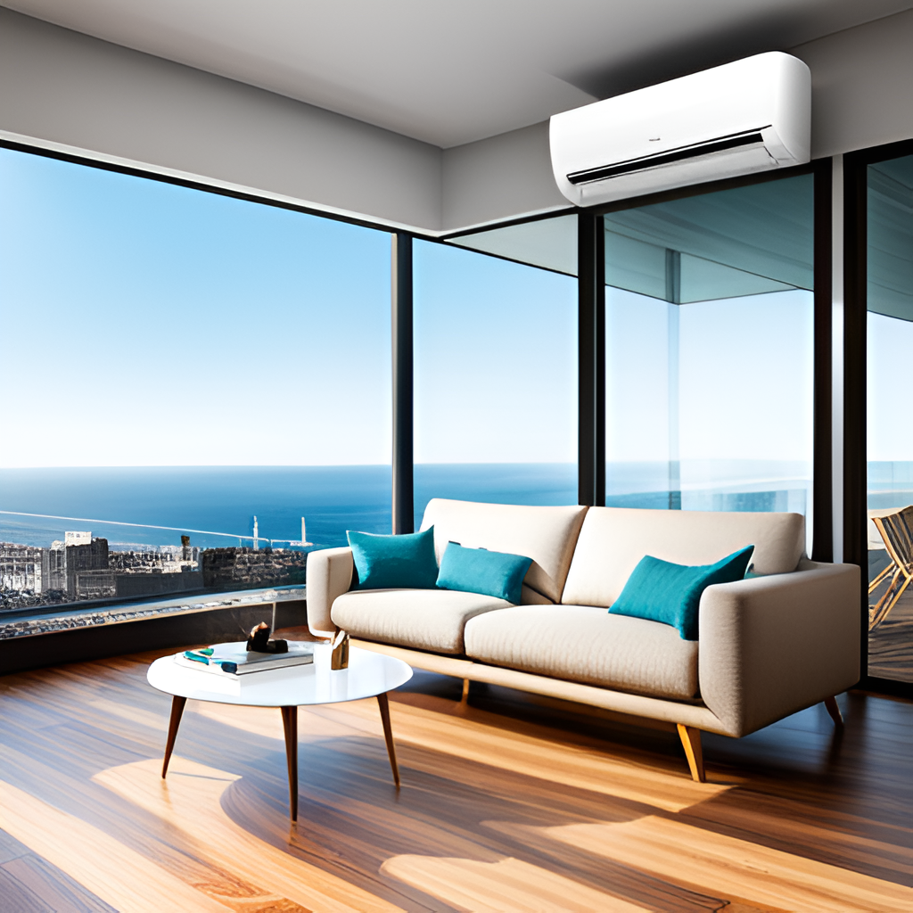
Our Technology
Smart Temperature Control
Our Airconditioner uses advanced sensors and algorithms to automatically adjust the temperature to your desired comfort level.
Energy Efficiency
Quiet Operation
Our Airconditioner is designed to be energy efficient, with a high SEER rating and programmable settings to reduce energy consumption when not in use.
Our Airconditioner uses advanced noise reduction technology to operate quietly, ensuring a peaceful home environment.

Slide 5
Customer Reviews
“The COSY Airconditioner has exceeded my expectations. It's efficient, easy to use, and has made a noticeable difference in my home's comfort level.”

Slide 6
Contact Us
Thank you for considering COSY Airconditioner. If you have any questions or would like to learn more about our products and services, please don't hesitate to contact us using the information below:
Email: wajid2303D@aptechorangi.com
Phone: +92 331 6227701
Address: V3C6+PW PECHS, Karachi, Pakistane

Slide 7
Thank you

